Slide 1
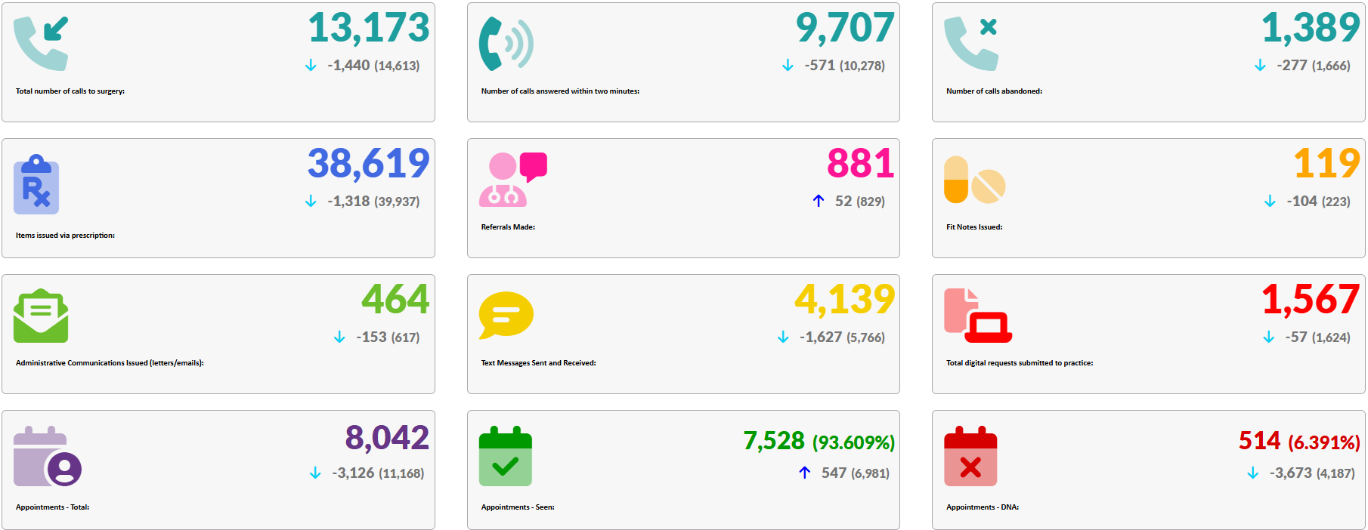
GP Activity Data
November 2024

